Slide 1
Rasberry Pi Repeater
The 186 Supreme Dream Team All-Stars
David Boschwitz, Ryan Wendell, Omar Taylor

Slide 2
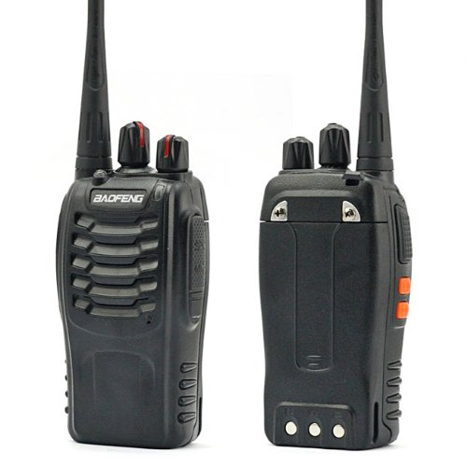
Quick Project Description
A repeater network of a VOIP connected Raspberry Pi computers hooked into small 5W transistor radios to allow for long-range communication typically unseen with normal two-way radios.

Slide 3

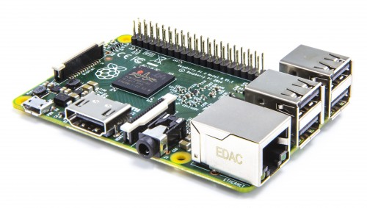
Full Project Description
A repeater network using a network of Voice-Over-IP connected Raspberry Pi computers hooked into small 5W transistor radios. This would allow long-range communications where normal two-way radios would not be able to reach without using cell phones. We would set up a repeater in one area (i.e. Iowa State) where it would receive all two-way radio transmissions on a specific channel and then it would be transmitted to all the repeaters on the VOIP network which would transmit the message out of the connected two-way radio. If the time is allotted we would also allow use on mobile devices with our hardware in order to communicate without the use of the radio receivers.

Slide 4

Language
Because the raspberry pi is a computer we could code in any language we wanted to, although coding in Java and Python worked best for us.
With more time, could make a web admin panel that would allow a user to connect to it and change settings without physical access to the repeater.

Slide 5
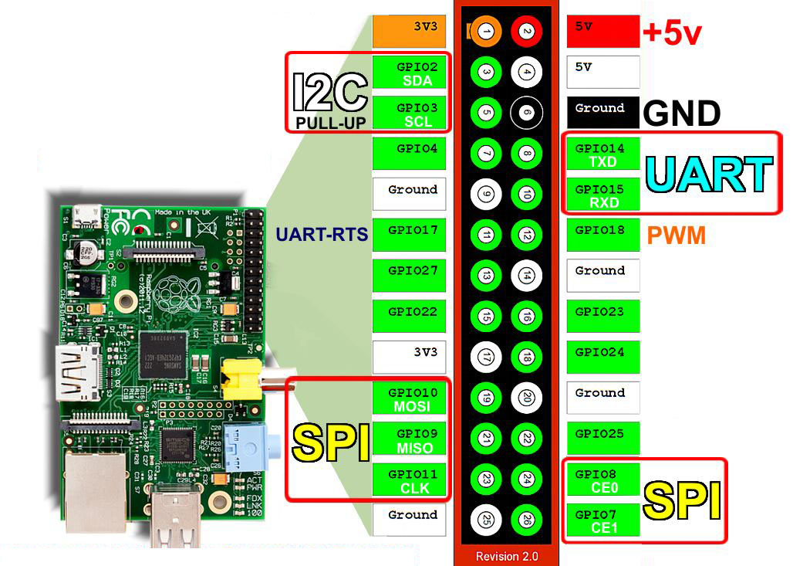
Hardware
Raspberry pi computer(s)
BaoFeng BF-888s Two-Way Radios
Any soundcards that may be needed to connect the radio and raspberry pi Ethernet Cable
Server Host
Bluetooth receiver

Slide 6
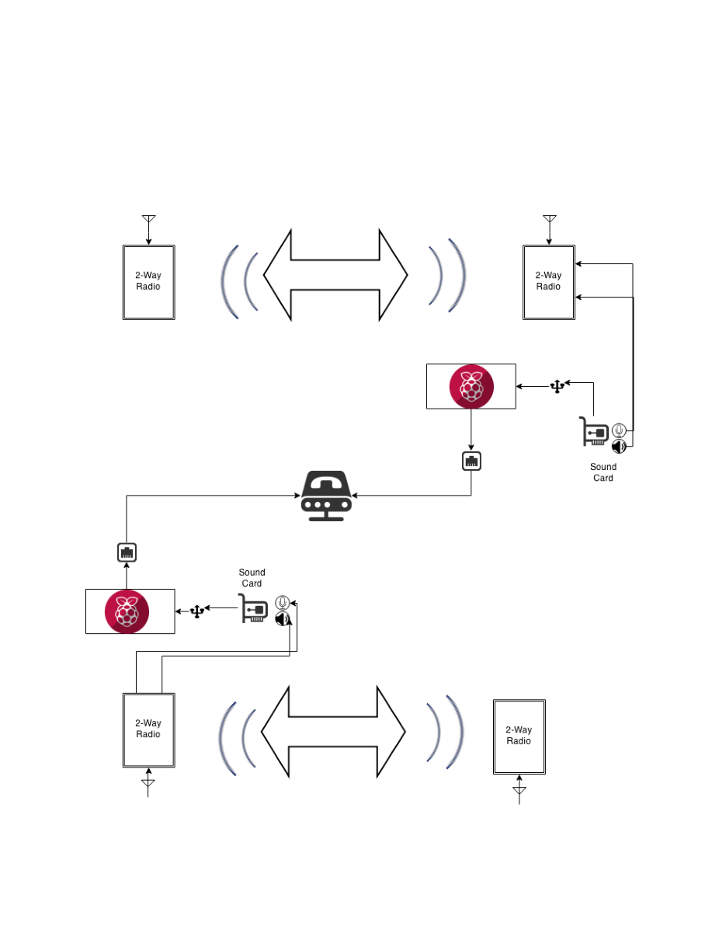
Block Diagram

